Slide 1
R basics workshop
June 20, 21 and 22, 2022 at the Missouri Botanical Garden
Website: http://rbasicsworkshop.weebly.com/

Slide 2
Instructors
J. Sebastián Tello
Center for Conservation and Sustainable Development
Missouri Botanical Garden
Eduardo Aguirre
Ph.D. Student. Washington University in St. Louis and
Missouri Botanical Garden

Slide 3
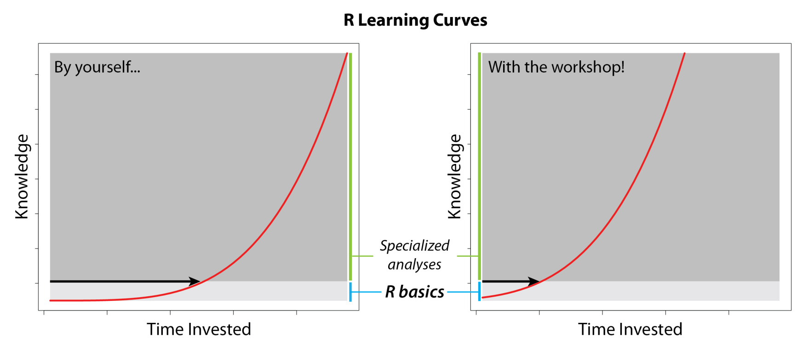
Objective
To teach the basic knowledge necessary to use R independently, thus helping participants initiate their own process of learning the specific tools needed for their research.

Slide 4
Logistics
Three full days, two sessions
First session 8:00 am to noon.
  A 15-minute break: 10:00 am to 10:15.
Lunch break noon to 1:30 pm.
Second session 1:30 pm to 5:00 pm.
  A 15-minute break: 3:00 am to 3:15.

Slide 5
Contents
http://rbasicsworkshop.weebly.com/

Slide 6
1. INTRODUCTION

Slide 7
What is R?
R is a language and environment for statistical computing and graphics. Environment = planned and coherent system of flexible tools (“An Introduction to R” by R Core Team).
R can be used for: data manipulation, data analysis, creating graphs, designing and running computer simulations.
R is extended by thousands of packages described in “Task Views” at CRAN (The Comprehensive R Archive Network): https://cran.r-project.org/web/views/

Slide 8
Why use R?
It is free

Slide 9
Why use R?
It is free
How can something free be so good?

Slide 10
Why use R?
It is free
How can something free be so good?
“… R is a social and subcultural phenomenon… propelled by incredible enthusiasm and altruism of hundreds of scientists who share their intellectual achivements on CRAN.”
From (Hackenberger, 2020, Croat Med. J. 61: 66-68)

Slide 11
Why use R?
It is free
How can something free be so good?
“The massive collective international effort represented by the R project exceeds the most idealistic Marxist imagination.”
From (Koenker, 2005, “Quantile Regression”)

Slide 12
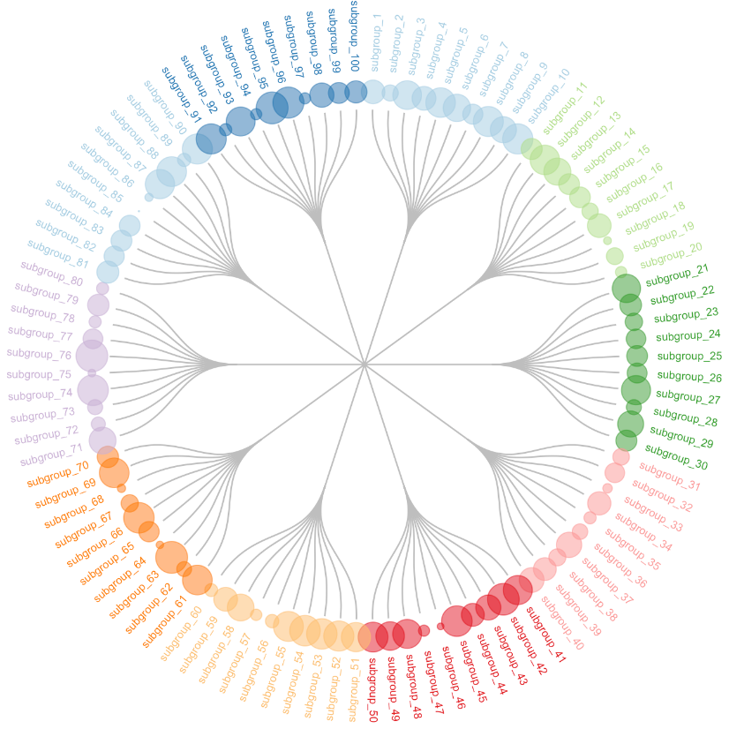
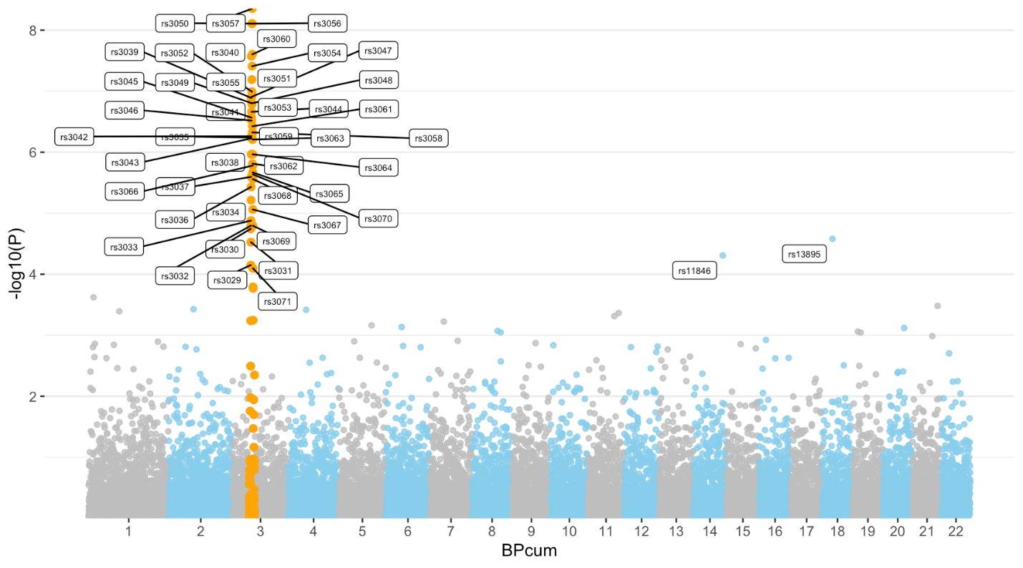
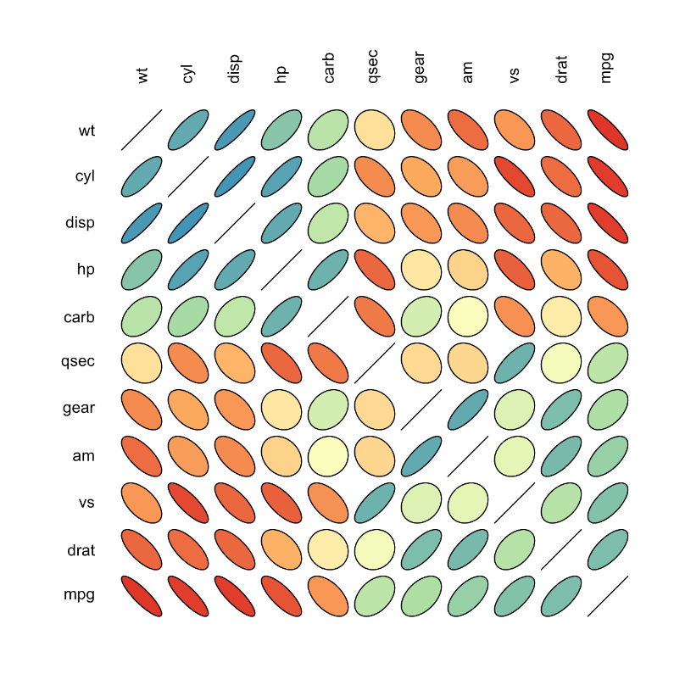
Why use R?
It is free
Excellent for graphics
From https://www.r-graph-gallery.com/index.html

Slide 13
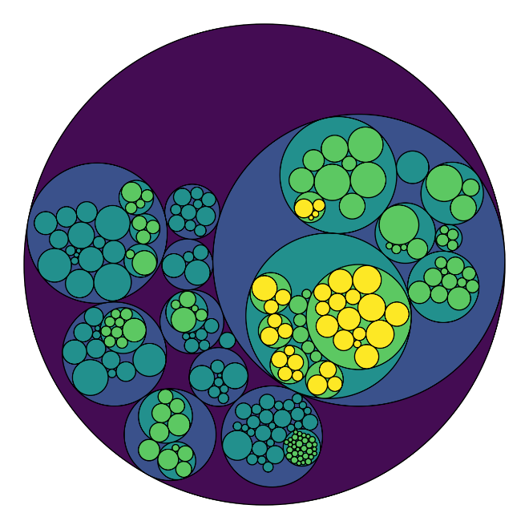
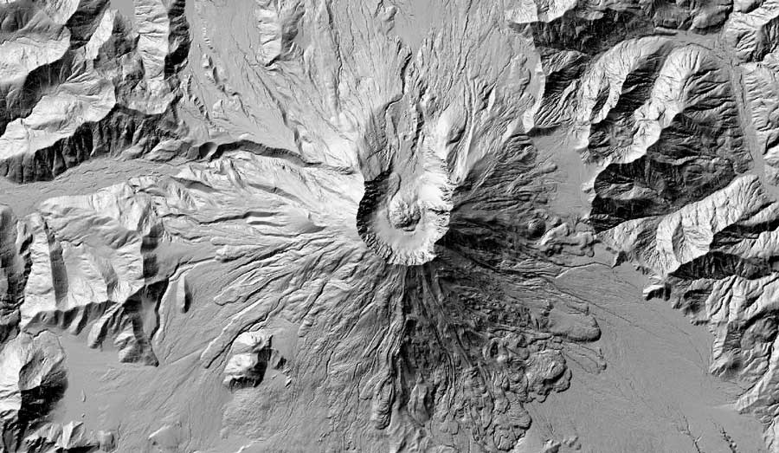
Why use R?
It is free
Excellent for graphics
From
https://www.r-graph-gallery.com/index.html
From http://rbyexamples.blogspot.com/2015/06/overlay-two-map-layers.html

Slide 14
Why use R?
It is free
Excellent for graphics
Tools for a wide range of statistical analyses

Slide 15
Bayesian | Bayesian Inference
Cluster | Cluster Analysis
Databases | Databases with R
DifferentialEquations | Differential Equations
Distributions | Probability Distributions
Econometrics | Econometrics
Environmetrics | Analysis Ecological Data
ExperimentalDesign | Design Analysis Experiments
ExtremeValue | Extreme Value Analysis
FunctionalData | Functional Data Analysis
Genetics | Statistical Genetics
Graphics | Graphic & Visualization
HighPerformanceComputing | Parallel Computing with R
Hydrology | Hydrological Data Modeling
MachineLearning | Machine Learning
MetaAnalysis | Meta-Analysis
MissingData | Missing Data
ModelDeployment | Model Deployment with R
Multivariate | Multivariate Statistics
NaturalLanguageProcessing | Natural Language Processing
NumericalMathematics | Numerical Mathematics
OfficialStatistics | Official Statistics & Surveys
Optimization | Mathematical Optimization
Phylogenetics | Phylogenetics
ReproducibleResearch | Reproducible Research
Robust | Robust Statistical Methods
Spatial | Analysis of Spatial Data
SpatioTemporal | Spatio-Temporal Data
Survival | Survival Analysis
TimeSeries | Time Series Analysis
Tracking | Processing Tracking Data
gR | gRaphical Models in R
Why use R?
It is free
Excellent for graphics
Tools for a wide range of statistical analyses
From CRAN Task Views at
https://cran.r-project.org/web/views/

Slide 16
Why use R?
It is free
Excellent for graphics
Tools for a wide range of statistical analyses
Recently developed tools available immediately

Slide 17
Why use R?
It is free
Excellent for graphics
Tools for a wide range of statistical analyses
Recently developed tools available immediately
Freedom to develop your own tools

Slide 18
The popularity of R
(From Lai et al. 2019. Ecosphere 10: e02567)

Slide 19
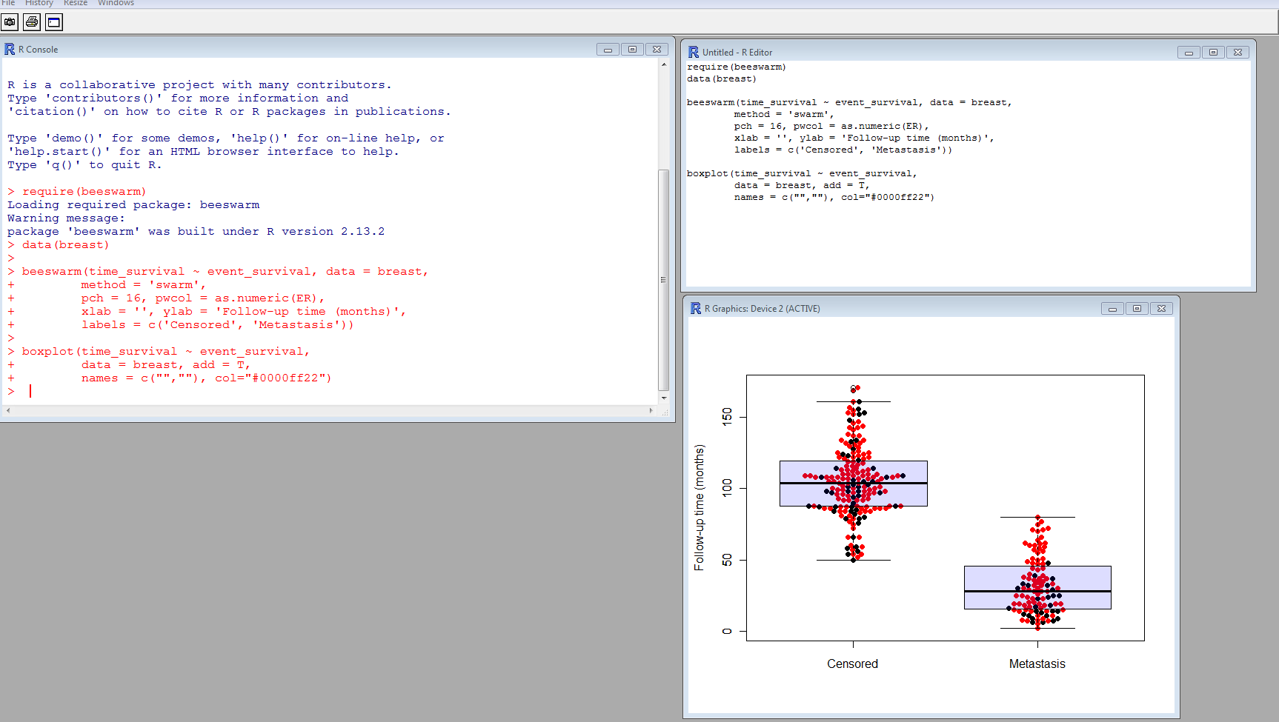
Three windows in R
Graphics
Console
Editor

Slide 20
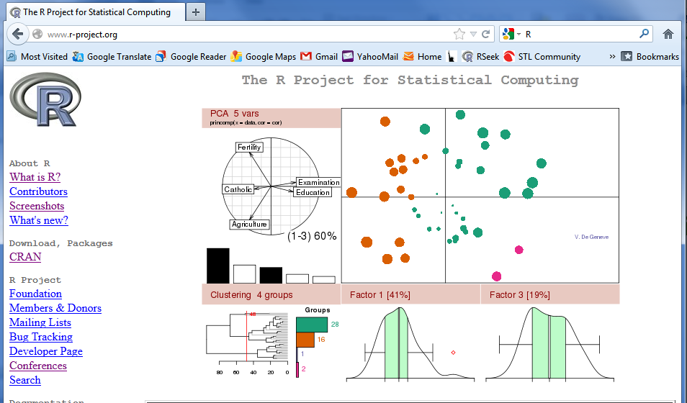
How to get R
From www.r-project.org. R is a GNU project.

Slide 21
Homework: Exercise 1.1
Objective: experiencing R

