Slide 1
Fundamentos de programación en R
Abril 29 – 30 y mayo 2 – 3, 2024
http://rbasicsworkshop.weebly.com/

Slide 2
Instructor(s)
J. Sebastián Tello
Center for Conservation and Sustainable Development
Missouri Botanical Garden
Iván Jiménez
Center for Conservation and Sustainable Development
Missouri Botanical Garden

Slide 3
Participantes
Alejandro Bucuru | Universidad Nacional de Colombia
Luisa Fernanda Ramírez | Universidad Nacional de Colombia

Slide 4
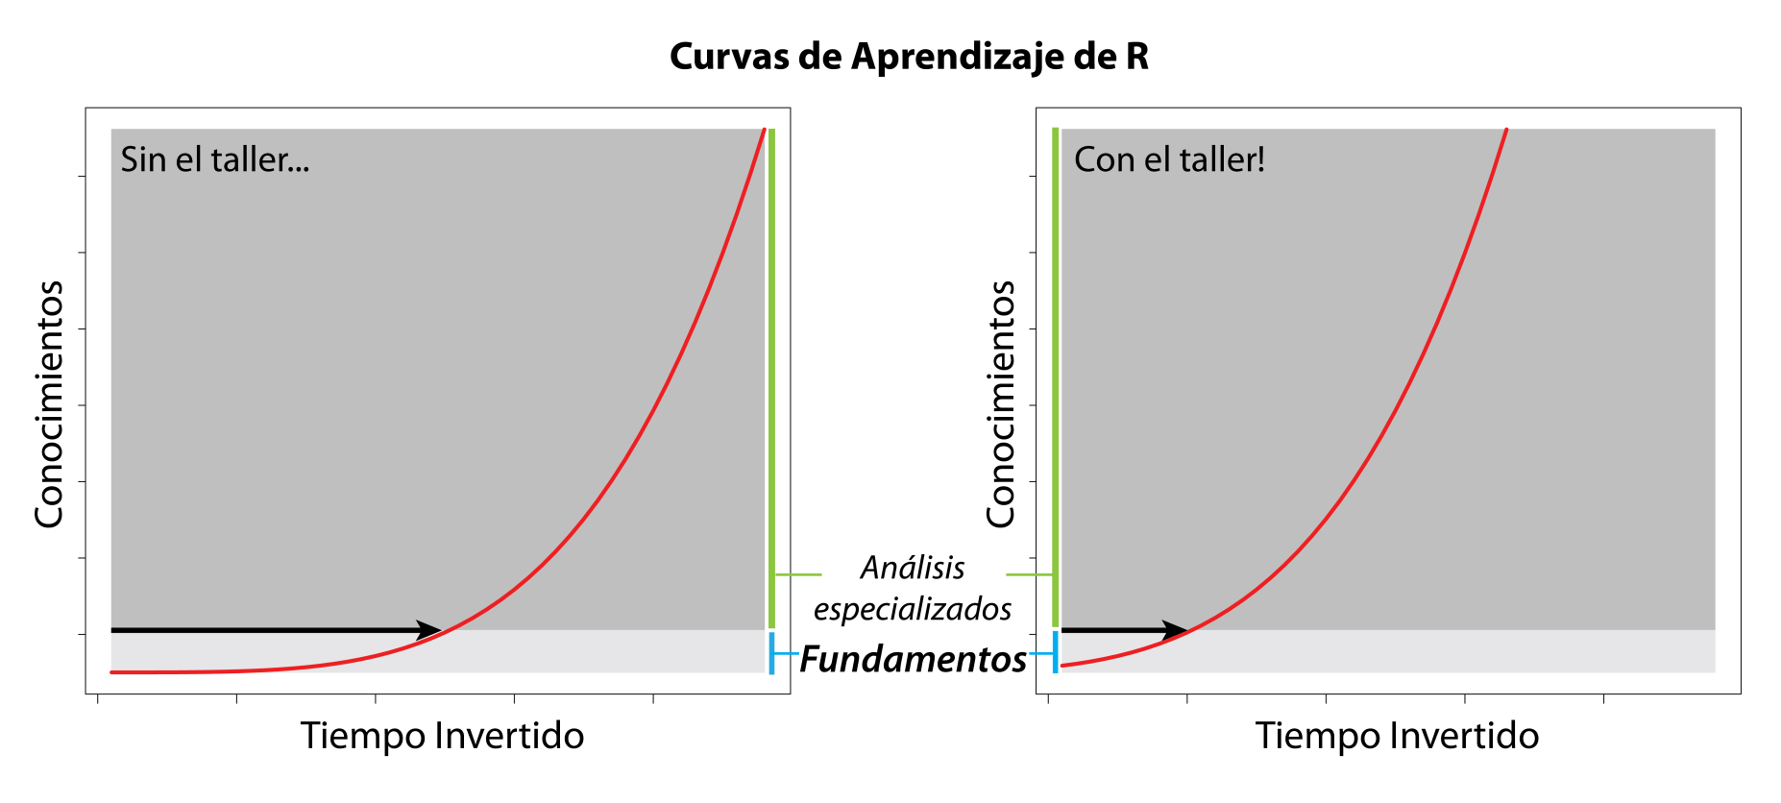
Objetivo – Fundamentos de R
El objetivo principal del taller es que los participantes conozcan y practiquen los conceptos básicos de programación en R, para que continúen utilizando y aprendiendo R independiente y eficientemente.

Slide 5
Logística
Lunes abril 29, martes abril 30 y jueves mayo 2:
Sesión 1 de 11:00 am a 11:50 am, enlace: https://meet.google.com/wno-uzzz-cff
Sesión 2 de 12:05 pm a 12:55 pm, enlace: https://meet.google.com/snd-szsf-wrb
Viernes mayo 3:
Sesión 1 9:00 am a 9:50 am, enlace: https://meet.google.com/wno-uzzz-cff
Sesión 2 10:05 am a 10:55 am, enlace: https://meet.google.com/snd-szsf-wrb

Slide 6
Temas
http://rbasicsworkshop.weebly.com/

Slide 7
1. INTRODUCCIÓN

Slide 8
¿Qué es R?
R es un lenguaje y ambiente de programación para análisis estadísticos y gráficos.
Lenguaje de programación porque está diseñado para expresar (comunicar) procesos que pueden ser llevados a cabo por computadoras.
Ambiente porque es un sistema planeado y coherente de herramientas.
Notes:
R is a statistical computing environment for statistical computation and graphics, and it is a computer language designed for typical and possibly very specialized statistical and graphical applications. The software is available for unix/linux, Windows, and Macintosh platforms
under general public license, and the program is available to download from www.r-project.org. Thousands of contributed packages are also available as well as utilities for easy installation.

Slide 9
¿Para qué sirve R?
Para manipular y analizar datos, crear gráficas, diseñar y realizar simulaciones en conmputadores.
La versatilidad de R es aumentada por miles de ”paquetes” descritos en “Task Views” en CRAN (The Comprehensive R Archive Network): https://cran.r-project.org/web/views/

Slide 10
¿Por qué usar R?
Es gratis

Slide 11
¿Por qué usar R?
Es gratis
¿Cómo algo gratis puede ser tan bueno?
“… R is a social and subcultural phenomenon… propelled by incredible enthusiasm and altruism of hundreds of scientists who share their intellectual achivements on CRAN.”
From (Hackenberger, 2020, Croat Med. J. 61: 66-68)

Slide 12
¿Por qué usar R?
Es gratis
¿Cómo algo gratis puede ser tan bueno?
“The massive collective international effort represented by the R project exceeds the most idealistic Marxist imagination.”
From (Koenker, 2005, “Quantile Regression”)

Slide 13
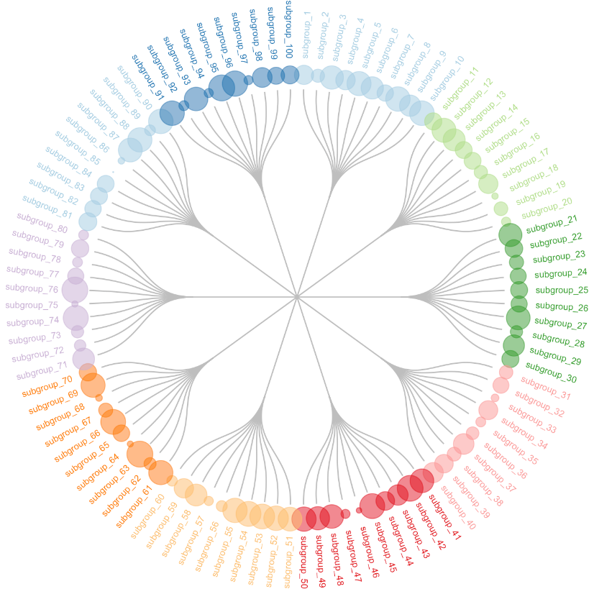
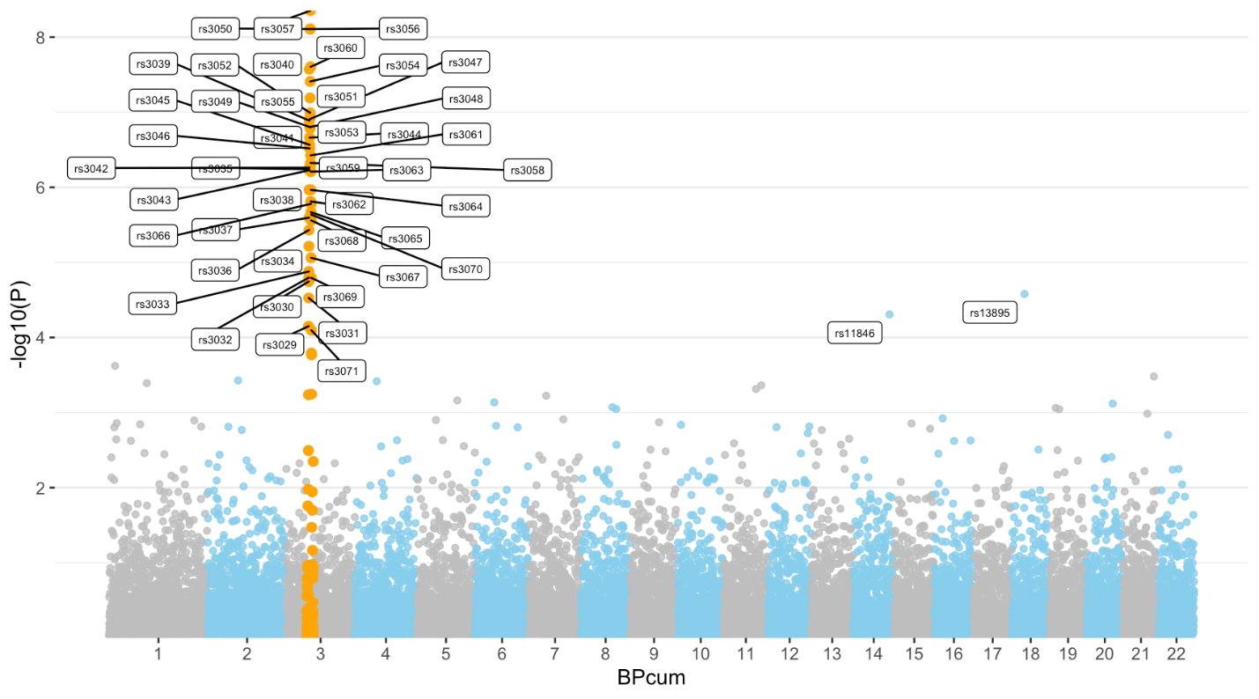
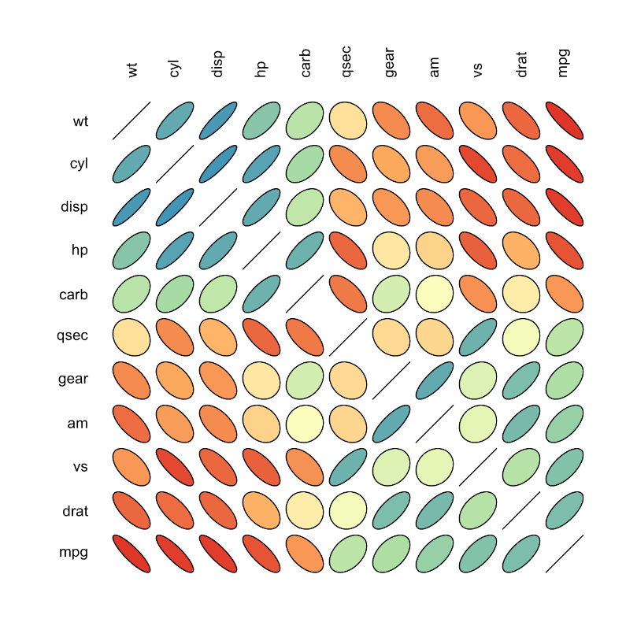
¿Por qué usar R?
Es gratis
Excelente para gráficas
From https://www.r-graph-gallery.com/index.html

Slide 14
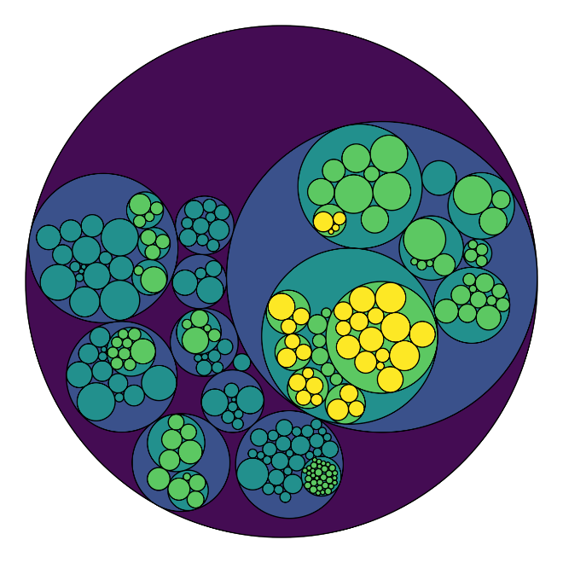
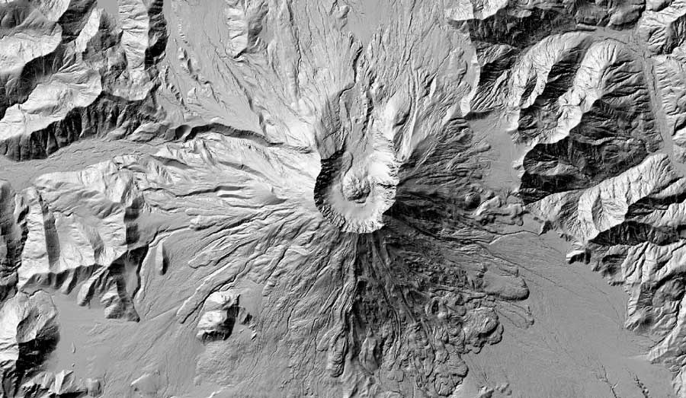
¿Por qué usar R?
Es gratis
Excelente para gráficas
From
https://www.r-graph-gallery.com/index.html
From http://rbyexamples.blogspot.com/2015/06/overlay-two-map-layers.html

Slide 15
Bayesian | Bayesian Inference
Cluster | Cluster Analysis
Databases | Databases with R
DifferentialEquations | Differential Equations
Distributions | Probability Distributions
Econometrics | Econometrics
Environmetrics | Analysis Ecological Data
ExperimentalDesign | Design Analysis Experiments
ExtremeValue | Extreme Value Analysis
FunctionalData | Functional Data Analysis
Genetics | Statistical Genetics
Graphics | Graphic & Visualization
HighPerformanceComputing | Parallel Computing with R
Hydrology | Hydrological Data Modeling
MachineLearning | Machine Learning
MetaAnalysis | Meta-Analysis
MissingData | Missing Data
ModelDeployment | Model Deployment with R
Multivariate | Multivariate Statistics
NaturalLanguageProcessing | Natural Language Processing
NumericalMathematics | Numerical Mathematics
OfficialStatistics | Official Statistics & Surveys
Optimization | Mathematical Optimization
Phylogenetics | Phylogenetics
ReproducibleResearch | Reproducible Research
Robust | Robust Statistical Methods
Spatial | Analysis of Spatial Data
SpatioTemporal | Spatio-Temporal Data
Survival | Survival Analysis
TimeSeries | Time Series Analysis
Tracking | Processing Tracking Data
gR | gRaphical Models in R
¿Por qué usar R?
Es gratis
Excelente para gráficas
Herramientas para un amplio rango de
análisis estadísticos
From CRAN Task Views at
https://cran.r-project.org/web/views/

Slide 16
Bayesian | Bayesian Inference
Cluster | Cluster Analysis
Databases | Databases with R
DifferentialEquations | Differential Equations
Distributions | Probability Distributions
Econometrics | Econometrics
Environmetrics | Analysis Ecological Data
ExperimentalDesign | Design Analysis Experiments
ExtremeValue | Extreme Value Analysis
FunctionalData | Functional Data Analysis
Genetics | Statistical Genetics
Graphics | Graphic & Visualization
HighPerformanceComputing | Parallel Computing with R
Hydrology | Hydrological Data Modeling
MachineLearning | Machine Learning
MetaAnalysis | Meta-Analysis
MissingData | Missing Data
ModelDeployment | Model Deployment with R
Multivariate | Multivariate Statistics
NaturalLanguageProcessing | Natural Language Processing
NumericalMathematics | Numerical Mathematics
OfficialStatistics | Official Statistics & Surveys
Optimization | Mathematical Optimization
Phylogenetics | Phylogenetics
ReproducibleResearch | Reproducible Research
Robust | Robust Statistical Methods
Spatial | Analysis of Spatial Data
SpatioTemporal | Spatio-Temporal Data
Survival | Survival Analysis
TimeSeries | Time Series Analysis
Tracking | Processing Tracking Data
gR | gRaphical Models in R
¿Por qué usar R?
Es gratis
Excelente para gráficas
Herramientas para un amplio rango de
análisis estadísticos
Herramientas nuevas disponibles rápidamente

Slide 17
Bayesian | Bayesian Inference
Cluster | Cluster Analysis
Databases | Databases with R
DifferentialEquations | Differential Equations
Distributions | Probability Distributions
Econometrics | Econometrics
Environmetrics | Analysis Ecological Data
ExperimentalDesign | Design Analysis Experiments
ExtremeValue | Extreme Value Analysis
FunctionalData | Functional Data Analysis
Genetics | Statistical Genetics
Graphics | Graphic & Visualization
HighPerformanceComputing | Parallel Computing with R
Hydrology | Hydrological Data Modeling
MachineLearning | Machine Learning
MetaAnalysis | Meta-Analysis
MissingData | Missing Data
ModelDeployment | Model Deployment with R
Multivariate | Multivariate Statistics
NaturalLanguageProcessing | Natural Language Processing
NumericalMathematics | Numerical Mathematics
OfficialStatistics | Official Statistics & Surveys
Optimization | Mathematical Optimization
Phylogenetics | Phylogenetics
ReproducibleResearch | Reproducible Research
Robust | Robust Statistical Methods
Spatial | Analysis of Spatial Data
SpatioTemporal | Spatio-Temporal Data
Survival | Survival Analysis
TimeSeries | Time Series Analysis
Tracking | Processing Tracking Data
gR | gRaphical Models in R
¿Por qué usar R?
Es gratis
Excelente para gráficas
Herramientas para un amplio rango de
análisis estadísticos
Herramientas nuevas disponibles rápidamente
Libertad: desrrollar y compartir herramientas

Slide 18
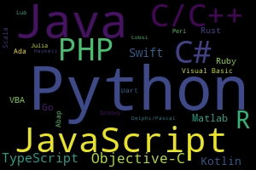
Popularidad de R
https://pypl.github.io/PYPL.html
https://www.tiobe.com/tiobe-index/

Slide 19
Popularidad de R
(From Lai et al. 2019. Ecosphere 10: e02567)

Slide 20
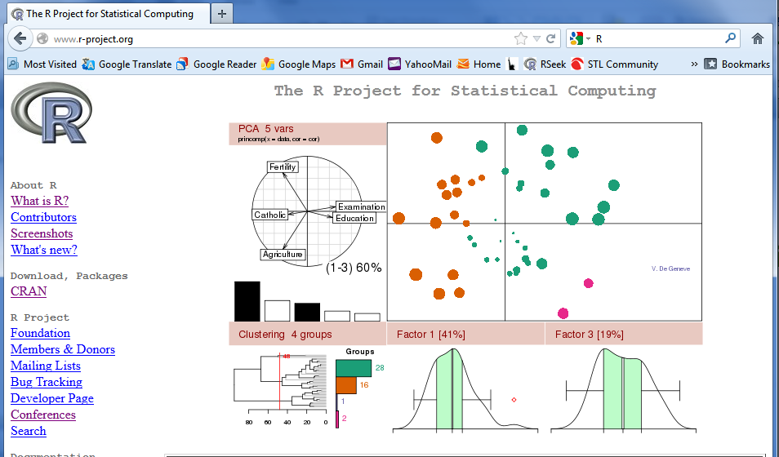
¿Cómo obtener R?
Aquí: www.r-project.org.

Slide 21
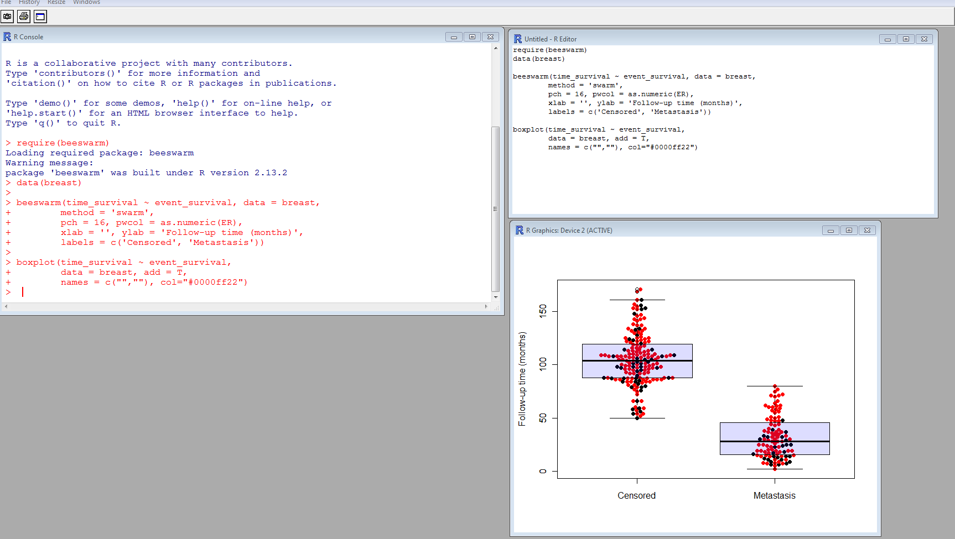
Tres ventanas en R
Gráficos
Consola
Editor

Slide 22
Tarea: Ejercicio 1.1
Objetivo: familiarizarse con la interfaz de R

